Slide 1
D.A. DAVIDSON 20TH ANNUAL DIVERSIFIED INDUSTRIALS & SERVICES VIRTUAL CONFERENCE
SEPTEMBER 23, 2021

Slide 2
FORWARD-LOOKING STATEMENTS AND NON-GAAP FINANCIAL DISCLOSURES
Forward-Looking Statements
This material and related presentation contain certain forward-looking statements. Any such comments speak only as of the date on the cover of this slide deck and EMCOR assumes no obligation to update any such forward-looking statements, unless required by law. These forward-looking statements may include statements regarding anticipated future operating and financial performance, the nature and impact of our remaining performance obligations, our ability to pursue acquisitions, our ability to return capital to shareholders, market opportunities, market growth, and customer trends. These forward-looking statements involve risks and uncertainties that could cause actual results to differ materially from those anticipated (whether expressly or implied) by the forward-looking statements. Accordingly, these statements are no guarantee of future performance or events. Such risks and uncertainties include, but are not limited to, adverse effects of general economic conditions, changes in the political environment, changes in the specific markets for EMCOR’s services, adverse business conditions, availability of adequate levels of surety bonding, increased competition, unfavorable labor productivity, mix of business, and the impact of the COVID-19 pandemic on our revenue and operations. Certain of the risk factors associated with EMCOR’s business are also discussed in Part I, Item 1A. “Risk Factors,” of the Company’s 2020 Form 10-K, and in other reports filed from time to time with the Securities and Exchange Commission and available at www.sec.gov and www.emcorgroup.com. Such risk factors should be taken into account in evaluating any forward-looking statements.
Non-GAAP Measures
This material and related presentation may include certain financial measures that were not prepared in accordance with U.S. generally accepted accounting principles (GAAP). The Company uses these non-GAAP measures as key performance indicators for the purpose of evaluating performance internally. We also believe that these non-GAAP measures provide investors with useful information with respect to our ongoing operations. Any non-GAAP financial measures presented are not, and should not be viewed as, substitutes for financial measures required by GAAP, have no standardized meaning prescribed by GAAP and may not be comparable to the calculation of similar measures of other companies.

Slide 3
EMCOR HIGHLIGHTS
Leading specialty construction, building, and industrial services provider
Nearly 73 million hours worked in 2020
2020 Total Recordable Incident Rate (TRIR) of 1.20
Q2 2021 RPOs of $5.1B

Slide 4
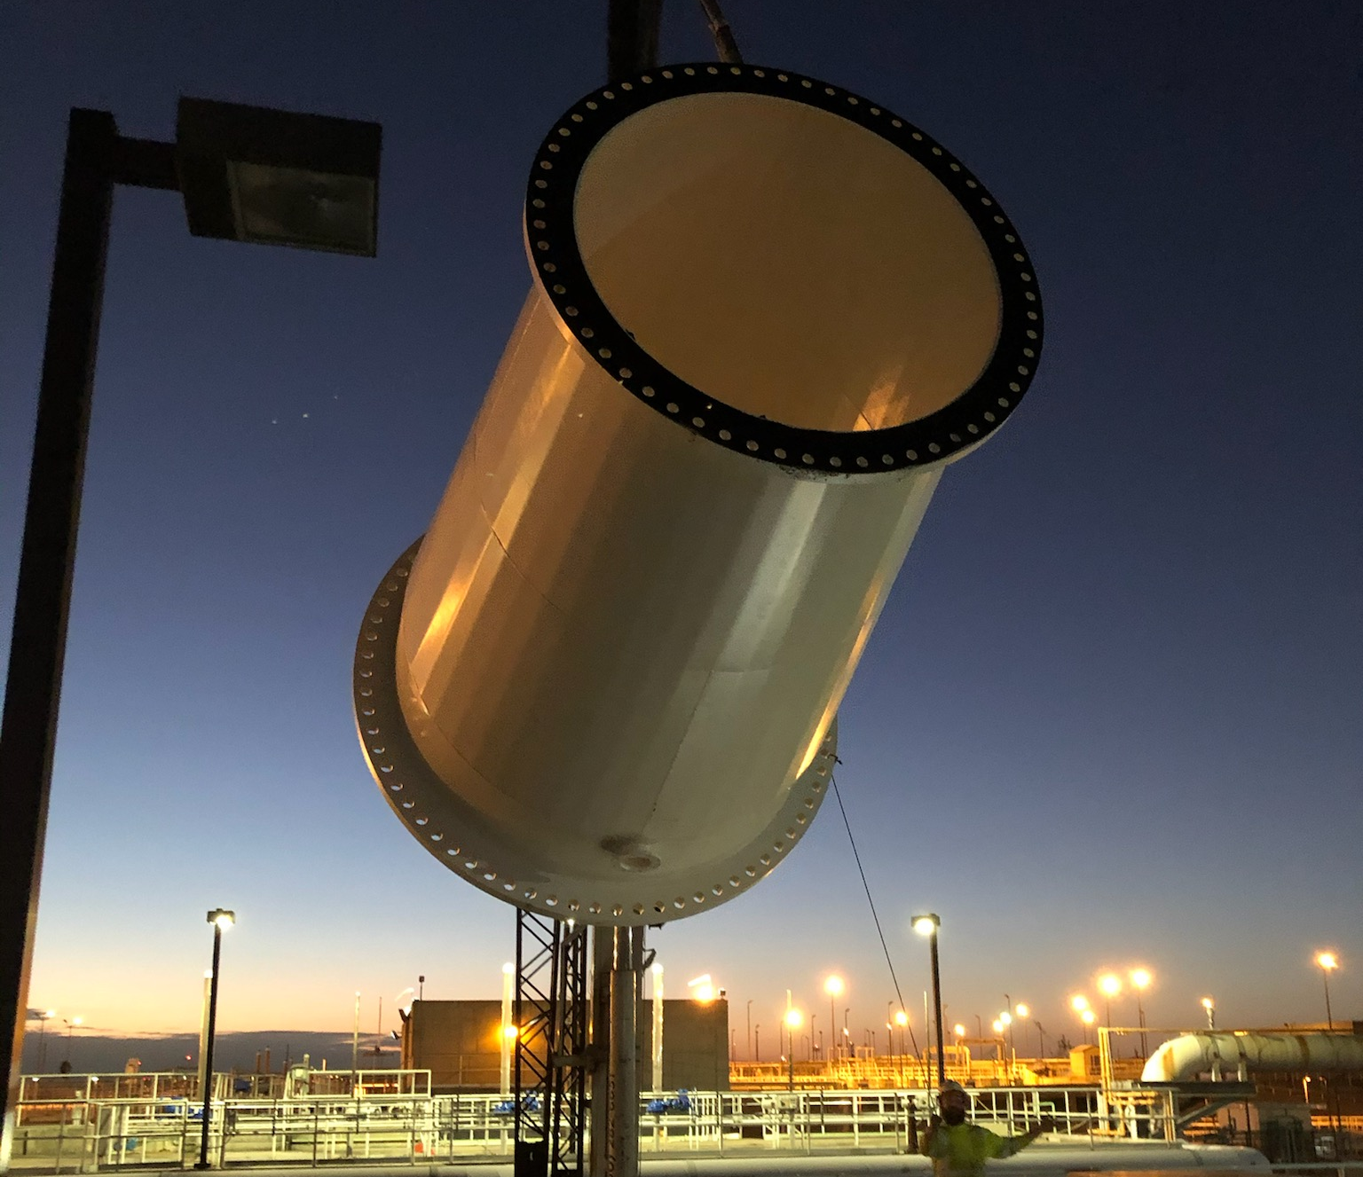
Emcor strengths
Significant expertise in project execution and managing skilled craft labor
Disciplined and effective cost management
Broad opportunities for earnings growth
History of consistent cash generation
Strong and liquid balance sheet

Slide 5
BROAD CONSTRUCTION & SERVICES PLATFORM 2020 REVENUES: $8.8B
CONSTRUCTION * |  |  | SERVICES
CONSTRUCTION SERVICES |  |  | BUILDING SERVICES |  |  |  |  |  |  |  | INDUSTRIAL SERVICES
Mechanical | Electrical |  | Mobile | Site-Based |  | Government |  |  | EMCOR UK |  | Refinery / Petro Chemical / Turnaround Services
Revenues $3.5B | Revenues $2.0B |  | Revenues $2.1B |  |  |  |  |  | Revenues $0.4B |  | Revenues $0.8B
Sheet Metal HVAC Process Piping High Purity Piping Plumbing Fire Protection | Low Voltage Voice & Data Lighting Security/Alarm High Voltage Transmission & Distribution |  | National HVAC Service Building Control Systems Retrofit Projects Repair Services Service Agreements IAQ Services | O&M HVAC Services Retrofit Projects Preventive Maintenance Energy Efficiency Upgrades | O&M HVAC Services Retrofit Projects Preventive Maintenance Energy Efficiency Upgrades | Base Ops Facilities Management IDIQ Projects O&M Supplier Management | Base Ops Facilities Management IDIQ Projects O&M Supplier Management |  | Integrated Facilities Services IDIQ Projects O&M Supplier Management |  | Heat Exchanger Services / Fabrication Embedded Contracts Turnaround Services Specialty Welding Maintenance & Capital Projects Process Controls Renewable Energy / Solar
* ~10% of construction revenues are services

Slide 6
GROWTH OPPORTUNITIES
Well positioned in growing non-residential markets/ trades
Data Centers | Strong Electrical / Mechanical / Fire Protection demand across Mid-Atlantic, Pacific Northwest, Midwest and Southeast
Warehouses | Continued buildout of e-commerce supply chain driving strong Fire Protection demand
Industrial / Manufacturing | Growing Electrical / Mechanical opportunities driven by continued re-shoring of supply chain to Southeast and relocations from higher-cost states Additional food processing opportunities
Healthcare | Electrical / Mechanical system retrofits growing as hospitals upgrade, see more flexibility in their existing facilities and build new facilities
Water & Wastewater | Demand for comprehensive construction services, especially Florida
Mechanical Services | Growing Mechanical service demand stemming from maintenance deferrals, retrofit opportunities and energy efficiency upgrades
Indoor Air Quality | Nationwide Mechanical Systems HVAC retrofit upgrades and tenant fit-out projects to improve building wellness with significant opportunities developing in the Institutional and Education sectors
Fire Protection | Nationwide fire sprinkler installation capability / substantial cost efficiencies via prefabrication / growing aftermarket

Slide 7
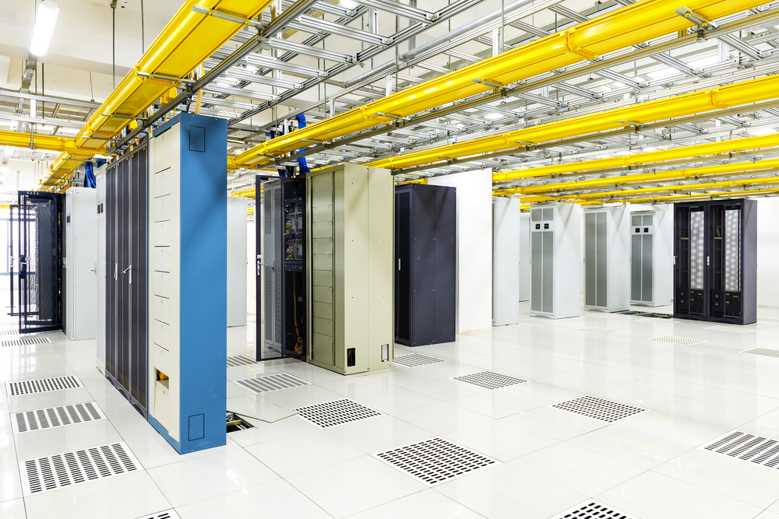
MARKET OUTLOOK – DATA CENTERS
Demand across Mid-Atlantic, Pacific Northwest, Midwest, and the Southeast remains strong
Electrical Construction
Mechanical Construction
Fire Protection Systems
CUSTOMER BASE
Technology Companies
Financial Firms
Co-locators
Government
“Average” Data Center Build % Ranges
Electrical Construction 30% - 50% *
Mechanical Construction 15% - 35% *
Fire Protection (Sprinkler Installation) 3% - 7%
* Includes purchase of major equipment

Slide 8
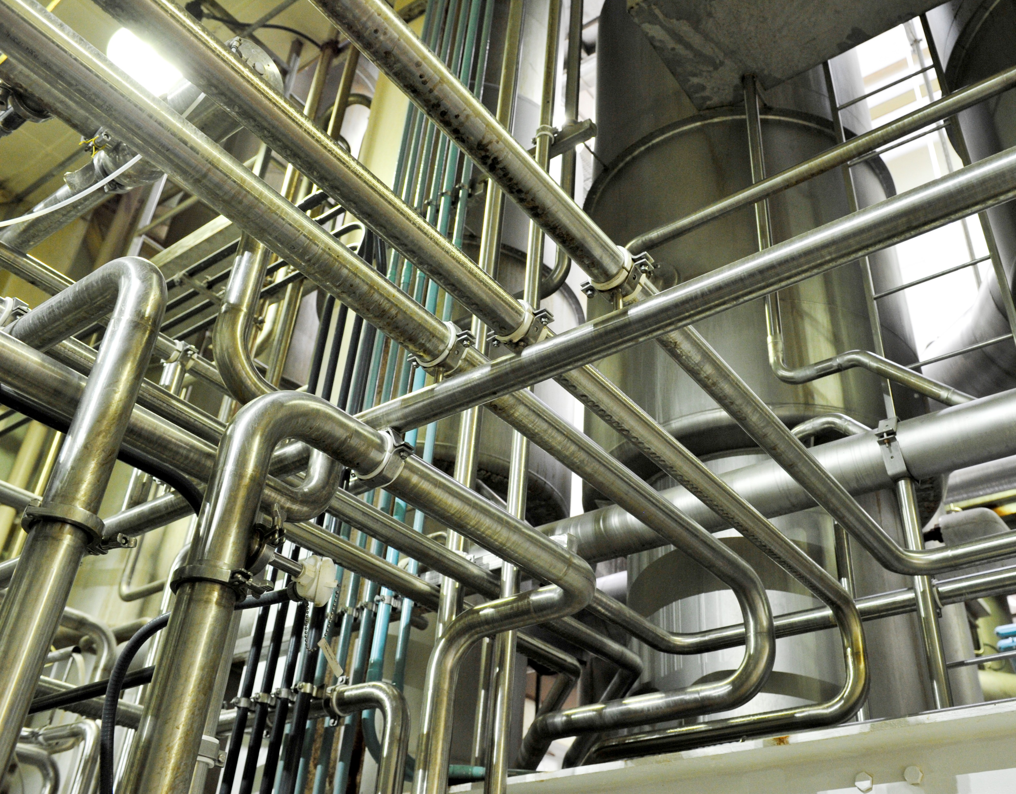
MARKET OUTLOOK – INDUSTRIAL / MANUFACTURING
Well-positioned for re-shoring of supply chain to Southeast locations from higher-cost states Many food processing opportunities
Electrical Construction
Mechanical Construction
Fire Protection Systems
Process Controls
CUSTOMER BASE
E-Commerce
National Food Brands
Auto Parts Makers
Specialized Environments

Slide 9
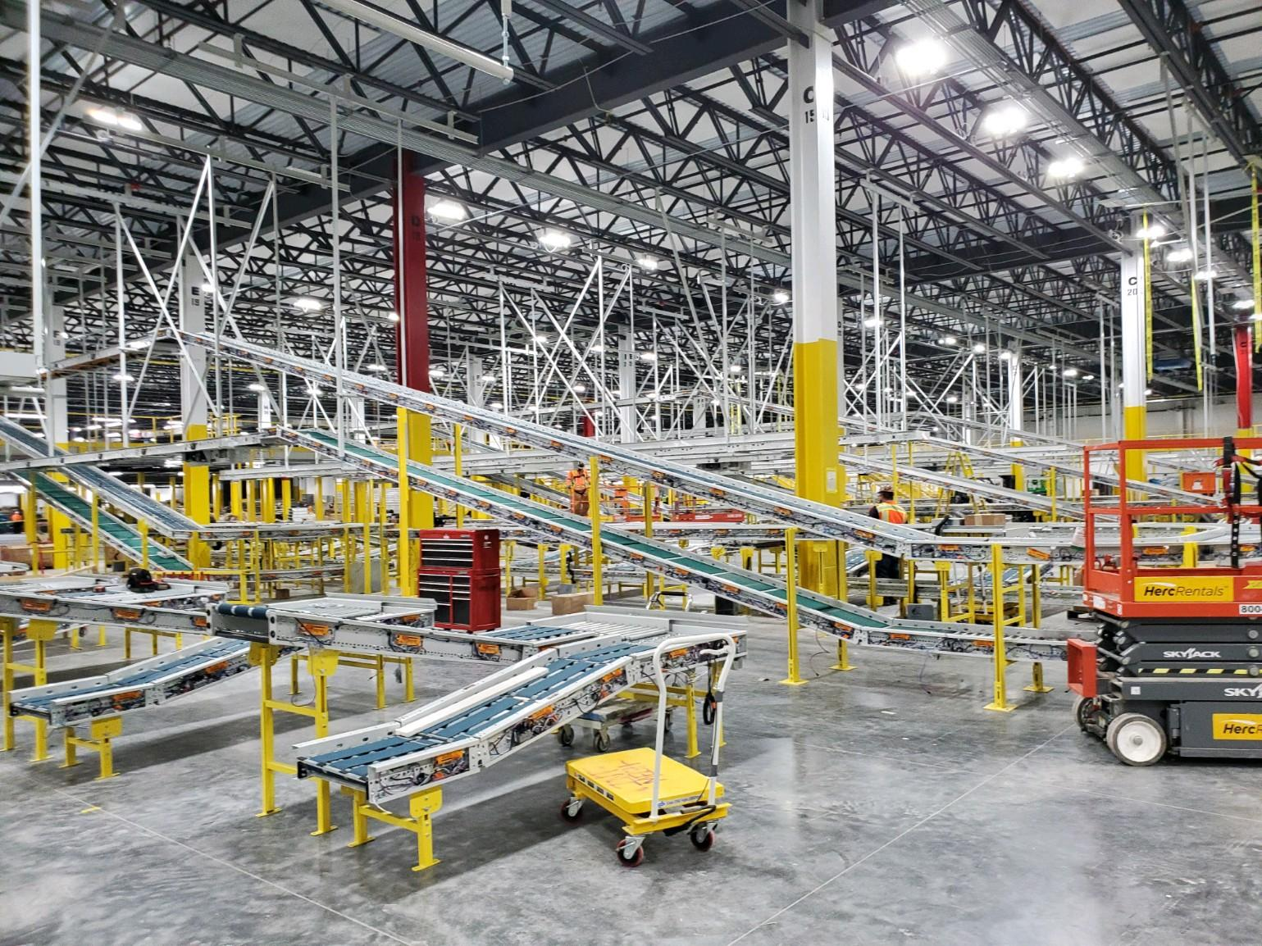
MARKET OUTLOOK – WAREHOUSES / FIRE PROTECTION
E-Commerce supply chain driving strong fire protection demand
Fire Protection Systems
Mechanical Construction
Active Aftermarket
CUSTOMER BASE
Technology Companies
Food Processing / Cold Storage
Distribution Centers

Slide 10
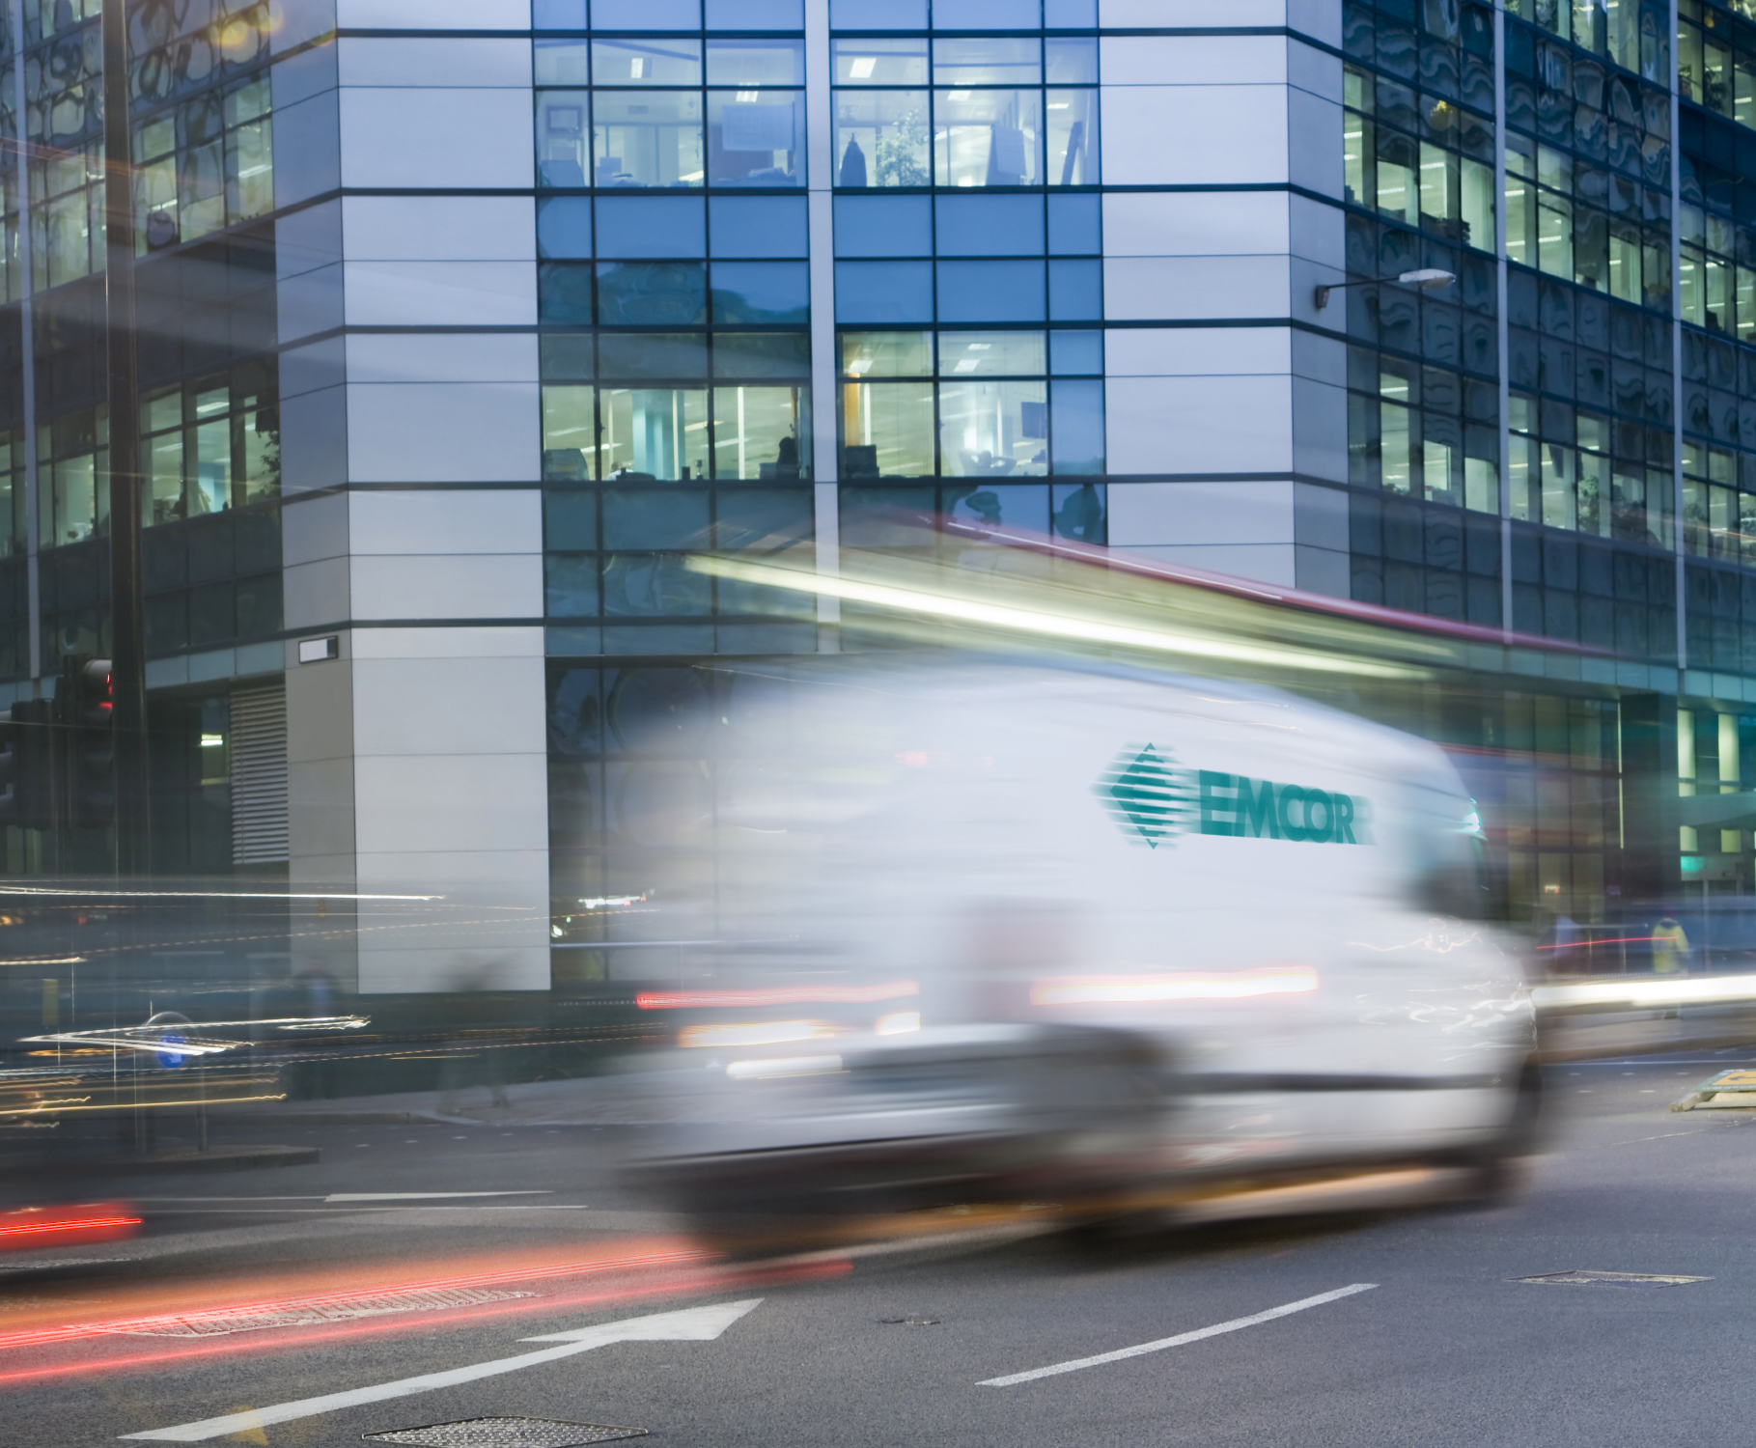
MARKET OUTLOOK – MECHANICAL SERVICES
Growing demand stemming from maintenance deferrals, retrofit opportunities, efficiency upgrades, and IAQ
Mobile Mechanical Services
Building Automation & Controls
Onsite Facilities Services
Government Services
CUSTOMER BASE
Commercial Buildings
National Brands and Organizations
Federal, State, and Local Government
Specialized Environments

Slide 11
CURRENT EMPHASIS ON HVAC INDOOR AIR QUALITY (IAQ) SOLUTIONS
1
EMCOR MECHANICAL HVAC CAPABILITIES
Nationwide scope and expertise in all HVAC Systems
New Construction
Core
Tenant Fit-Out
Mechanical Retrofit
Equipment / System Replacement
Energy Retrofit
Building Control Systems
Building Wellness
Energy / Efficiency Upgrades
IAQ Solutions
Air Flow Circulation
Reduce Airborne Pathogens and Particulates
Keep Cooling Coils Clean
Reduce System Maintenance
2
INDOOR AIR QUALITY
A building’s indoor air quality significantly impacts the productivity, health, and comfort of its occupants through greater circulation and changeout of air in confined spaces
Filter Replacement
UV Lamp Technology
Increase Surface Decontamination
Increase Airborne Inactivation
Needlepoint Bipolar Ionization Technology
3
RECENT CASE STUDY
Client: Large multi-state corporation
Goal: Demonstrate IAQ improvements to employees
Locations: 240 buildings (90+ sites)
Assets: 1,000 mostly packaged units and split systems
EMCOR Solutions
UV for Increased Surface Decontamination

Slide 12
RPOs BY MARKET SECTOR – 6/30/21
Diverse Remaining Performance Obligations (RPOs) of $5.1 billion
7%
($ Millions) (Unaudited)
2021 – Qtr. 2
11%
6%
40%
10%
12%
13%
1%

Slide 13
PRIORITIZING SUSTAINABILITY
Our Mission First, People Always values continue to guide our sustainability strategy
Recent Updates
Aligned our sustainability reporting with the Sustainability Accounting Standards Board (SASB) standard for the Engineering & Construction Services industry, in-line with our shareholders’ expectations and our commitment to strong sustainability practices Incorporated guidance from the recommendations of the Task Force on Climate-Related Financial Disclosures (TCFD) to disclose scope 1 and scope 2 greenhouse gas emissions metrics and set forward-looking reduction goals
Our 2035 Energy and Emissions Goals
Committed to the Health & Safety of our Workforce
30-40%
Per capita reduction in carbon-based fuel consumption across service fleet
We maintain a strong commitment to safety throughout our operations, striving for a zero injury environment and culture across our 85 operating subsidiaries
YTD – 6/30/21
TRIR
2020 Outcome
TRIR
Industry Average
20%
Reduction in per capita greenhouse gas output
1.15
1.20
2.90
We maintain our position as an industry leader in safety and continue to make progress toward our goal of zero workplace injuries
Our Board and management team continue to oversee our ESG practices and guide our strategy as we progress our goals and initiatives

Slide 14
KEY FINANCIAL DATA – INCOME STATEMENT
($ Thousands, except per share information)
(Unaudited)
* Excluding impairment loss on goodwill, identifiable intangible assets, and other long-lived assets in Qtr. 2 2020

Slide 15
KEY FINANCIAL DATA – BALANCE SHEET
($ Thousands)

Slide 16
BALANCED CAPITAL ALLOCATOR
EMCOR Capital Allocation by Year (%)
~40%
~60%
2015 - 2020
% of Revenue 3% 5% 3% 4% 4% 3%
Business Reinvestment
Shareholder Return
Acquisitions
Capex
Dividends
Share Repurchases

Slide 17
REMAINING 2021 OUTLOOK
First priority – continued focus on employee health and safety
Remain essential service – no new COVID restrictions that would impact operations
Bidding / bookings activity remains strong for both fast-paced and technically complex projects
Small project bookings are strong
Oil & gas market remains challenged but outlook strengthens as year progresses into 2022
U.K. remains strong and stable
Maintain the flexibility provided by our strong and liquid balance sheet

Slide 18
GUIDANCE ASSUMPTIONS UPDATE
Multiple assumptions are trending better than expected - supporting guidance raise
Original 2021 Assumptions
Mid-Year Update
Non-res. market flat to modestly down
Up mid-single digits
Healthy organic revenue growth
Better than expected organic revenue growth
Market for IAQ, energy efficiency, and small project work would be strong
Market even stronger than expected
Challenging refinery environment
Fundamentals improving into 2022
Secular growth markets (infrastructure, data centers, healthcare, manufacturing) would be strong
Secular growth markets remain strong and continue to drive growth
Continue to manage challenging labor market
Labor market would be challenging
Stable to moderate price increases for materials
Material prices have increased
Challenging supply-chain environment

Slide 19
2021 GUIDANCE
Assuming the impact of the COVID-19 pandemic does not worsen, no major disruptions (e.g. stay-at-home orders or closures)
Revenues ~$9.5 Billion
Diluted EPS* $6.65 - $7.05
* Assumes 27% - 28% effective tax rate

