Slide 1
Subaward Application Process
IFES Sri Lanka Briefing

Slide 2
Purpose
IFES seeks to work with organizations to implement projects related to democracy, elections, and inclusive political participation. Often, IFES issues subawards to organizations for such projects.
Before issuing subawards, however, IFES needs to identify qualified organizations. To do this, IFES issues Requests for Applications (RFAs).
RFAs outline the general scope of work for a project and the basic requirements that organizations must meet in order to be considered for a subaward.
In response to RFAs, interested organizations prepare applications and submit them to IFES, in line with a timeline outlined in the RFA.
Upon receipt of applications, IFES evaluates them and selects one or more organizations for a subaward, depending on the project.

Slide 3
Introduction

Slide 4
Basic Requirements
Proposal
Proposals describe how organizations will organize and implement projects. It describes the organization’s proposed technical approach.
Attachment A in the RFA provides the template for proposals
Budget
Budgets provide a detailed breakdown of the costs for the overall project.
Budgets are organized around expense categories such as staffing, office expenses, and program activities.
IFES provides an Excel budget template to organizations to use

Slide 5
Basic Requirements
Organizational Profile
It is important that organizations provide background details about themselves. IFES needs to know who the organizations are and what relevant experience and expertise they have.
Attachment C in the RFA provides a form that organizations should use to provide this information to IFES.
Supporting Documents
Most recent final and signed audit/financial statement (when available)
Proof of organization’s registration
CVs of key personnel

Slide 6
Proposals

Slide 7
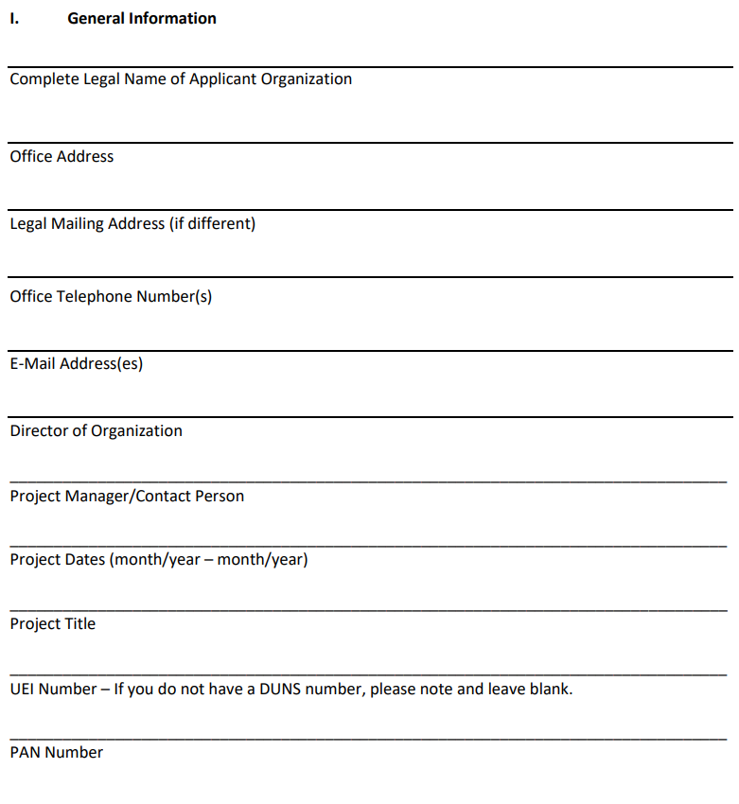
Section 1: General Information
The first section of the proposal is “General Information.”
In this section, you will simply provide basic details such as the legal name of organization, your office address, contact information, etc.
If there’s anything in this section that you are unclear about, you can always contact IFES for clarification.

Slide 8
Section 2: Technical Approach
This is the most important section of the proposal. This is where you will describe your project in detail.
As much as possible, you should try to keep this section to a maximum of 5 pages
This section includes multiple sub-sections that need to be completed.
Project Summary
Need for Project
Project’s Goal & Objectives
Target Audience & Stakeholders
Activities
Expected Deliverables

Slide 9
A) Project Summary
The Project Summary should provide a high-level overview of the project.
It should briefly cover the essential details of the project, such as the overall objective(s), key activities, target audience(s), and geographic coverage.
Do not be too descriptive. The point of the Project Summary is for the reader to have a general idea of what your project is. The other sub-sections will provide the detailed information.
The Project Summary should be short. One paragraph should be enough.

Slide 10
B) Need for the Project
In this section, you will describe the key problem(s) that your project aims to address.
This section allows you to demonstrate your knowledge and expertise. Show us that you understand the problem(s).
Describe the problem(s) accurately and back up your claims with examples and data as much as possible.
Do not forget to make it clear how your project connects to the problems(s) you have identified.
This section, however, does not need to be very long. You do not need to provide detailed analysis. It is not a research paper. Just make sure your points are clear and substantiated.

Slide 11
C) Project’s Goal and Objectives
Goal
Objectives
The Project Goal should be high-level and align with the overall aim of your project.
Sometimes, the Project Goal may be noted in the RFA’s scope of work. If not, you can develop your own. Just make sure the Project Goal is in line with the RFA’s scope of work.
The Project Goal does not have to be something that the project can achieve on its own. It can be something that the project can contribute to.
Example: “To increase women’s representation in parliament.”
Objectives are narrower in scope. They are more specific.
Objectives should contribute to the Project Goal. Think about it this way: if you achieve the objectives, the Project Goal is more likely to be achieved.
You should be able to achieve the objectives during the life of the project.
Example: “To enhance the leadership and campaign skills of women candidates for parliament”
Example: “To raise awareness about the importance of women’s representation in parliament.”

Slide 12
D) Target Audience & Stakeholders
Target Audience
Stakeholders
Briefly note who the target audience(s) will be for your project.
You should not have a lot of target audience(s). A project may have only one.
To identify your target audience(s), ask yourself these questions:
Who are you primarily trying to reach through your activities?
Will any specific group of people benefit from your activities?
Stakeholders are people or entities that have an interest in your project. Often, they will be engaged in your activities.
For example, if you have a project focused on training women candidates, possible stakeholders could be political parties, members of parliament, and the election commission.
To identify your stakeholders, ask yourself these questions:
Will we coordinate or collaborate with any group or entity?
Are there any groups of people or entities whose support or buy-in we need?
Will our project support the target audience to build relationships with other groups of people or entities?

Slide 13
E) Activities
In this section, you will identify various activities that you will implement as part of your project. Activities are the core component of the project and therefore this sub-section should include more detail.
For each activity, you should create an activity title with a numbering system. Please try to list activities in chronological order as much as possible.
Under each activity, you should provide a description. Please include all the important details.
When drafting your activity descriptions, keep in mind the following questions:
What are we doing, i.e., what is the activity?
Why are we doing this activity, i.e., what does this seek to accomplish?
How are we doing this activity?
Where will the activity take place?
Who will be the target audience for this activity? How many?
Example
Activity 1: Development of training curricula
Activity 2: Training of trainers
Activity 3: Implementation of training program
Activity 4: Post-training mentorship and monitoring
Activity 5: Lessons learned workshop

Slide 14
F) Expected Deliverables
This section does not need to be very long. It can also be formatted as bullet points.
You should identify what key deliverables that you believe the project will produce.
For each deliverable, provide a short description.
Examples of deliverables could be reports, policy platforms, policy recommendations, action plans, advocacy or awareness-raising materials, training curricula, cooperation agreements, etc.

Slide 15
Section 3: Implementation Timeline

Slide 16
Section 4) Results Framework
Organizations should have at least a basic framework in place to monitor the progress of the project and measure the success of the project.
There is no set format that you have to use for the Results Framework. However, at a minimum, this section should outline some performance indicators, including what sources will be used to collect data for these indicators.
A basic example of a framework is provided below.
Results | Indicators | Sources
1. Leadership and campaign skills of women candidates for parliament are enhanced | 1.1. Number of women candidates that participate in training program | Attendance sheets
 | 1.2 Percentage of trained women candidates who demonstrate increased knowledge on campaign good practices | Pre- and post-tests
 | 1.3 Percentage of trained women who report applying knowledge from trainings in their campaigns | Surveys of training participants

Slide 17
Budget

Slide 18
Overview
You will need to prepare a detailed budget in Excel for your proposed project.
IFES has provided a budget template that you should use. The template already contains formulas. So, you should only need to input information into the document.
Please make sure that you account for all expected costs in the budget. Do not only include programming costs. Make sure you account for potential operational and administrative costs, too.
Please use Sri Lankan Rupee (LKR) for the budget.
Do not forget to use the “Notes” column. In this column, you should explain the budget line items so that IFES reviewers can understand why you budgeted for something the way you did.

Slide 19
Expense Categories
Program Staff Labor
This category accounts for all the costs related to salaries and wages of staff who will work on the project.
Do not forget to budget for staff who will provide financial and administrative support.
Office Expenses
This category accounts for all the basic expenses related to maintaining and operating an office that is being used for the project
Examples of costs include stationary, electricity, internet, postage, printing, rent, etc.
Furniture & Equipment
This category accounts for furniture and equipment you may need to buy or replace for this project, especially if you have to hire new staff for the project.
Examples include chairs, tables, desks, cabinets, laptops, printers, etc.

Slide 20
Expense Categories
Travel and Transportation
This category accounts for costs for that staff will incur to travel to different areas of the country to support project implementation as well as any costs for local transportation for your staff
Do not include travel and transportation costs for program participants.
Program Activities
This category accounts for all the costs directly associated with the organization and implementation of activities.
In this category, you should have a section for each activity listed in the proposal.
Examples of costs that could be included under each activity include venue hiring, printing of training materials, translation and interpretation services, participant travel costs, participant stipends, facilitation fees for non-staff trainers, etc.

Slide 21
Expense Categories
Other Direct Costs
This category accounts for all other costs that can be directly billed to the project but that do not fit into the other expense categories.
Examples of costs include bank fees, audit fees, etc.
Indirect Costs
This category accounts for costs that an organization occurs that cannot be billed (or easily billed) directly to a project.
Indirect costs are represented as a percentage of the total direct costs listed in the budget.
You may not have indirect costs. Each organization is different, and sometimes it is project-specific.

Slide 22
Organizational Profile

Slide 23
Overview
IFES requires an organizational profile for each applicant.
The RFA provides a template that should be used (see Attachment C).
This document contains four sections, which have been outlined in the following slide.
You should use this document to demonstrate that your organization has the relevant experience and expertise for the project. It should help convince us that you’re the best organization to work with.

Slide 24
Sections of the Organizational Profile
Summary
Human Resources
Past Performance
References
Briefly describe your organization as a whole.
You can mention when you were founded, what your mission is and what type of work you do.
This does not need to be long. One-two paragraphs should be sufficient.
Provide the full legal name of your organization’s director and/or CEO.
Briefly describe the key personnel that you will use for the project.
If you will be hiring new people for this project, please briefly describe your recruitment plans.
Provide a list of relevant projects that your organization has completed or is currently implementing
For each project, provide the name, a brief description of the activities, the donor, the amount, and the period of performance.
If you want, you can provide contact information for three references from previous donor-funded projects you have implemented or worked on.

Slide 25
Supporting Documents

Slide 26
List of additional documents
Do not forget, you also need to provide the following documents with your application :
Most recent final and signed audit/financial statement (when available)
Proof of organization’s registration
CVs of key personnel

Slide 27
Questions?

