Slide 1
NASDAQ: EMKR
December 3, 2021

Slide 2
Safe Harbor Statement
Forward-Looking Statements:
This presentation contains forward-looking statements within the meaning of the “safe harbor” provisions of the Private Securities Litigation Reform Act of 1995. Statements concerning future matters such as demand for our products, industry and market conditions, the development of new products, enhancements or technologies, sales levels, expense levels and other statements regarding matters that are not historical are forward-looking statements. These statements are based on management’s current expectations and beliefs and are subject to a number of factors and uncertainties that could cause actual results to differ materially from those described in the forward-looking statements, including without limitation, the following: (a) the rapidly evolving markets for the Company's products and uncertainty regarding the development of these markets; (b) the Company's historical dependence on sales to a limited number of customers and fluctuations in the mix of products and customers in any period; (c) delays and other difficulties in commercializing new products; (d) the failure of new products: (i) to perform as expected without material defects, (ii) to be manufactured at acceptable volumes, yields, and cost, (iii) to be qualified and accepted by our customers, and (iv) to successfully compete with products offered by our competitors; (e) uncertainties concerning the availability and cost of commodity materials and specialized product components that we do not make internally; (f) actions by competitors; (g) risks and uncertainties related to applicable laws and regulations, including the impact of changes to applicable tax laws; (h) acquisition-related risks, including that (i) the revenues and net operating results obtained from the Systron Donner Inertial, Inc. ("SDI") business may not meet our expectations, (ii) the costs and cash expenditures for integration of the SDI business operations may be higher than expected, (iii) there could be losses and liabilities arising from the acquisition of SDI that we will not be able to recover from any source, and (iv) we may not realize sufficient scale in our navigation systems product line from the SDI acquisition and will need to take additional steps, including making additional acquisitions, to achieve our growth objectives for this product line; (i) risks related to our ability to obtain capital; (j) risks related to the transition of certain of our manufacturing operations from our Beijing facility to a contract manufacturer’s facility; and (k) other risks and uncertainties discussed under Item 1A - Risk Factors in our Annual Report on Form 10-K for the fiscal year ended September 30, 2020, as updated by our subsequent periodic reports. All forward-looking statements are made as of the date hereof, based on information available to us as of the date hereof, and subsequent facts or circumstances may contradict, obviate, undermine, or otherwise fail to support or substantiate such statements. We do not intend to update any forward-looking statement to reflect subsequent events or circumstances, except as required by law or regulation.
Non-GAAP Financial Measures:
This presentation includes non-GAAP financial measures where indicated. The Company reports its financial results in accordance with GAAP. Additionally, the Company supplements reported GAAP financials with non-GAAP measures which are included in related press releases and reports furnished to the SEC, copies of which are available at the Company’s website: http://www.EMCORE.com or the SEC’s website at: http://www.sec.gov. These non-GAAP financial measures complement the Company’s consolidated financial statements presented in accordance with GAAP. However, these non-GAAP financial measures are not intended to supersede or replace the Company’s US GAAP results. These non-GAAP measures are presented in part to enhance the understanding of the Company’s historical financial performance and comparability between reporting periods. The Company believes the non-GAAP presentation, when shown in conjunction with the corresponding GAAP measures, provide relevant and useful information to analysts, investors, management and other interested parties. These non-GAAP measures are not in accordance with, or an alternative for measures prepared in accordance with GAAP, and may be different from non-GAAP measures used by other companies. In addition, these non-GAAP measures are not based on any comprehensive set of accounting rules or principles. The Company believes that non-GAAP measures have limitations in that they do not reflect all of the amounts associated with the Company’s results of operations as determined in accordance with GAAP. These measures should only be used to evaluate the Company’s results of operations in conjunction with the corresponding GAAP measures.

Slide 3
Key Company Facts
Leading provider of advanced mixed-signal devices that provide the foundation for today’s leading-edge aerospace & defense systems and high-speed broadband communication networks
Vertically integrated capabilities with world-class indium phosphide (InP) semiconductor Wafer Fabrication and Quartz MEMS facilities
Business Units focused on serving customers with excellence:
Aerospace & Defense
Inertial Navigation – QMEMS and Fiber Optic Gyroscope (FOG) products
Defense Optoelectronics
Broadband
Cable TV Optical Components
Chips and Sensing products
Founded in 1984, IPO in 1993
Primary Locations:
Alhambra, CA (HQ): InP Wafer Fab, FOG, Defense-Opto, Broadband, and Administrative Functions
Concord, CA: Quartz MEMS
Revenue, quarter ended 9/30/21 (fiscal 4Q) | $44.0M
Revenue, fiscal year ended 9/30/21 | $158.4M
Cash at 9/30/21 | $71.7M
Debt at 9/30/21 | $0.0M
Tangible Book Value at 9/30/21 | $137.2M
Market Capitalization 12/3/21 | $244.0M
Shares Outstanding 12/3/21 | 37.0M
Closing Share Price 12/3/21 | $6.60

Slide 4
Product Diversity and Financial Profits
Investment Highlights
Growing and differentiated A&D navigation business
Leading share in “downstream” optics for CATV
New products derived from existing technology:
Sensing: LiDAR and directional drilling
Defense Optoelectronics
Highly synergistic Optoelectronics and MEMS manufacturing operations
Business Growth & Profit Drivers
Broadband access driving CATV growth
Broadband gross margin improved by 10 margin points in FY21 YoY
Program Expansion with FOG and MEMS Products
Margin improvement and expense control drive growing profitability
($ in millions) | FY20 | FY21 | YoY Delta
Total Revenue | $110.1 | $158.4 | 44%
Non-GAAP Gross Margin^{(a)} | 33% | 39% | 6 pts
Non-GAAP Opex as a % of Revenue^{(a)} | 36% | 24% | (12 pts)
(a) See reconciliation for GAAP to non-GAAP in Appendix.

Slide 5
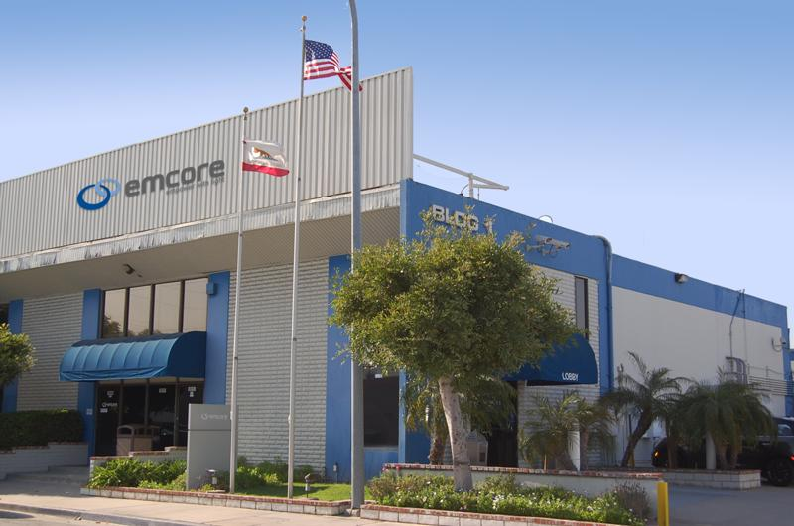
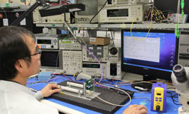
Product Differentiation
Mixed-Signal Devices
Bridge the analog physical world with digital computing & communications
EMCORE is among a small number of suppliers worldwide
Hybrid Vertical Integration strategy
InP Wafer Fabrication and Quartz MEMS facilities
In-house chip design
Higher product performance and lower costs
In-house manufacturing for specialized, high value-added processes that enhance differentiation (e.g., inertial navigation products)
EMS for all PCBAs, rack assemblies, and lower cost products that serve more cyclical markets (e.g., optical components)
Drives CSWaP (lower Cost, smaller Size, lighter Weight, and less Power)
EMCORE’s global leadership position in mixed-signal devices combined with vertical integration creates high-performance CSWaP differentiation across the entire product portfolio

Slide 6
Business Units
Aerospace & Defense (A&D)
Broadband
Inertial Navigation ($3B+ market)^{(a)}
Development and manufacture of sensors for use on aircraft, unmanned vehicles/drones, submarines, targeting platforms, and weapons (torpedoes, missiles, etc.)
Established leader in QMEMS navigation via acquisition of Systron Donner Inertial (SDI) in June 2019
Expanding market presence with internally-developed FOG products
Defense Optoelectronics (~$75M market)^{(b)}
Leader of high-frequency optical transmitters for radar and satellite communications
CATV Optical Products (~$100M market)
Market leader supplying optical transmitters and laser modules to OEMs for high-speed communication networks owned by multiple-system operators or MSOs (i.e. cable providers)
Additional Products/Markets
Chips – lasers, photo-detectors, MZ modulators, and gain chips
Sensing – high-power lasers for LiDAR and other optical sensing application
Leveraging mixed-signal and in-house manufacturing expertise to expand in A&D inertial navigation market, which is larger and less cyclical than the CATV market
Source: Yole High End Inertial Sensors Market Research Report 2020
Management estimates

Slide 7
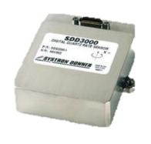
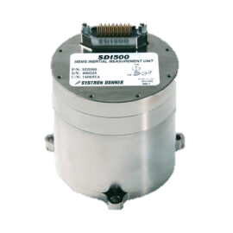
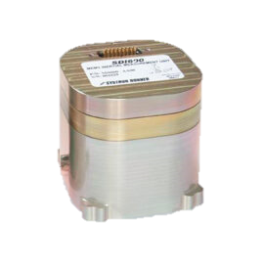
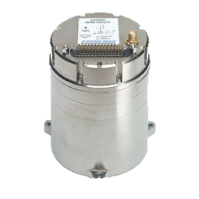
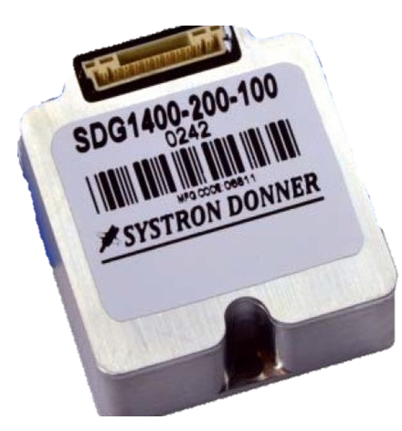
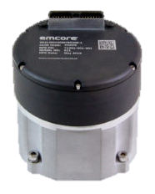
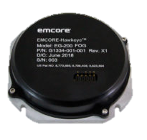
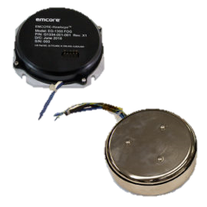
A&D – Navigation Products
Sensors
Packaged as single- or multi- axis
Measures angular or linear velocity
Inertial Measurement Unit (IMU)
Six sensors (3 gyroscopes & 3 accelerometers) and algorithms
Measures change in position and velocity
Inertial Navigation System (INS)
An IMU integrated with a GPS/GNSS chip and a computer
Determines location
QRS11 QMEMS Gyro
SDD3000 QMEMS Gyro
SDI505 QMEMS IMU
SDI600 QMEMS IMU
SDG500/1400 QMEMS Gyro
QRS28 QMEMS
Multi-Axis Gyro
SDN500
QMEMS INS
EN1000/2000
FOG
INS
EG120 FOG
EG200 FOG
EG1300 FOG
EN300 FOG IMU
EMCORE is one of the largest independent inertial navigation providers; offering a full suite of products for a broad range of requirements across the tactical- and navigation- grade market segments

Slide 8
A&D – Navigation Market
Tactical Grade Market Segment
QMEMS provides performance for a lower cost and with a smaller size than competing platforms – while also excelling in harsh environments
Common applications include platform stabilization (tanks, ships), torpedo guidance, flight control systems, and oil & gas drilling
Tactical and Navigation grades
EMCORE’s FOG technology enables superior performance while maintaining traditional FOG pricing and form factors
Common applications include unmanned vehicles, missile targeting, submarine sensors, and dismounted soldier systems (geo-compassing/north-finding)
$3B+ Global Inertial Navigation Market in 2019^{(a)}
$410M
$820M
$928M
$941M
Commercial
Grade
(e.g., industrial
robots)
Tactical Grade
(e.g., platform
stabilization)
Navigation Grade
(e.g., unmanned
vehicles)
Strategic
Grade
(e.g., nuclear
weapons)
Many Suppliers
Few Competitors
Two Primary Competitors
Highly Specialized
EMCORE is an Established QMEMS Market Leader and an Emerging Independent FOG Supplier
EMCORE’s Total Addressable Market (TAM) is $1.7B
(a) Source: Yole High End Inertial Sensors Market Research Report 2020

Slide 9
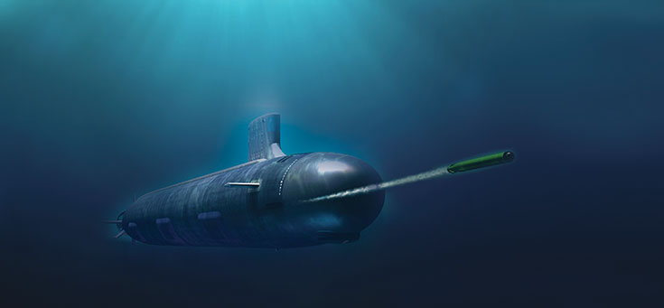
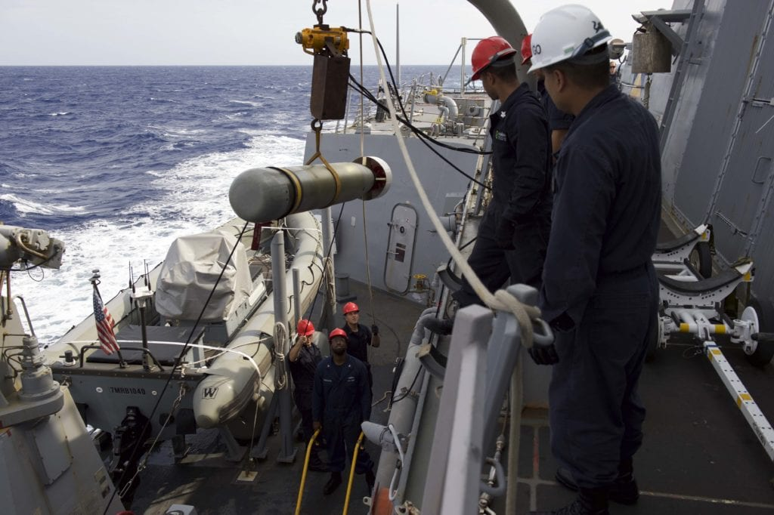
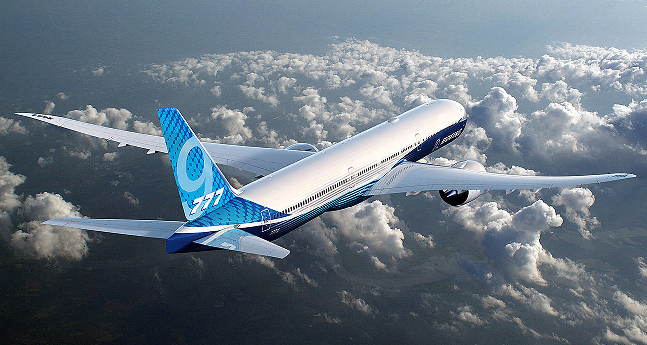
A&D – Navigation: QMEMS
EMCORE is one of only two QMEMS gyros suppliers worldwide
Well Established in Defense
SDI500 IMUs for the US Navy - Six Year Program
Mark 48 heavyweight submarine-launched torpedo program
Mark 54 lightweight anti-submarine torpedo program
Strong Position in Civil Aerospace
SDI300 IMUs for the Boeing 777 (four per aircraft)
Designed into 777 for the life of program
Flight control and navigation augmentation markets
Growth Opportunities
Increasing production output to fulfill pent-up demand
Converting to non-ITAR products that can open-up new markets
Entering additional weapons applications (smart bombs, anti-missile)
Developing products for new tactical and industrial grade applications
Trusted supplier of high-quality QMEMS products to Tier 1 contractors and global A&D players

Slide 10
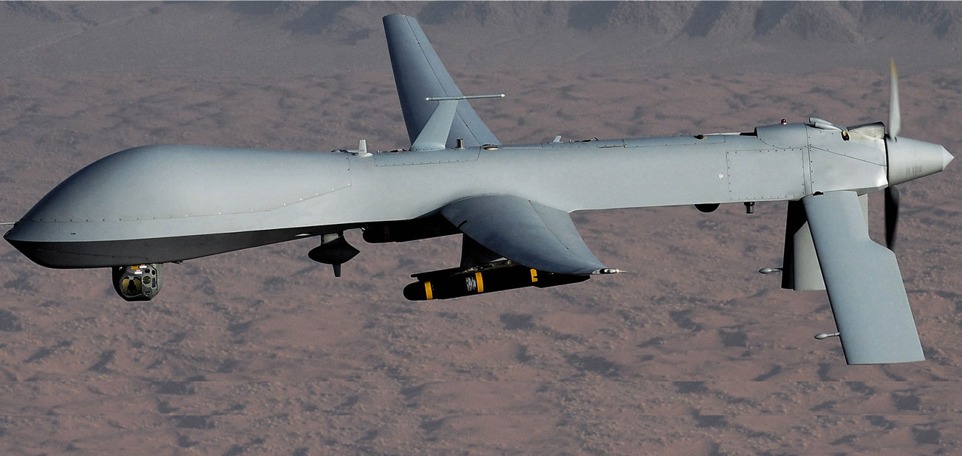
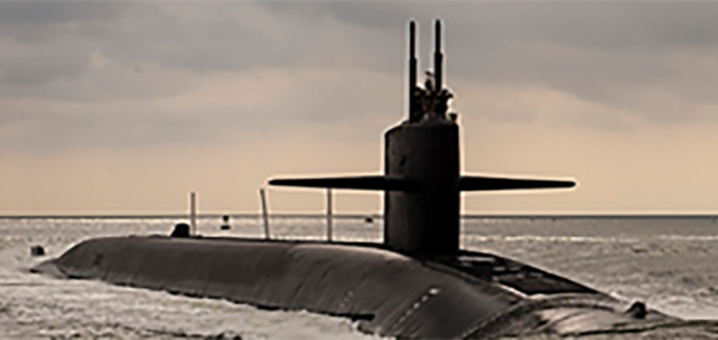
A&D – Navigation: FOG
Targeting growth opportunities in the FOG market
Established in Tactical Grade
Single-axis gyro supplier for Raytheon’s Multi-spectral Targeting System
Expanding into Navigation Grade
Pursuing a variety of applications including nuclear submarine sensors, munitions guidance, and primary navigation of aircraft
Currently in testing stages with several defense programs
Superior CSWaP Delivers Superior Capabilities & Differentiation
Same or higher performance at a lower or same cost
Enables form-fit-function “socket” replacements for legacy devices
Favorable Market Dynamics
EMCORE’s status as an independent provider, free of strategic conflict, provides customers an attractive alternative source
Expanding presence in the market for FOG products

Slide 11
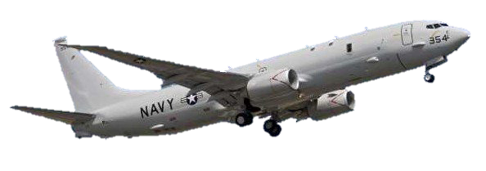
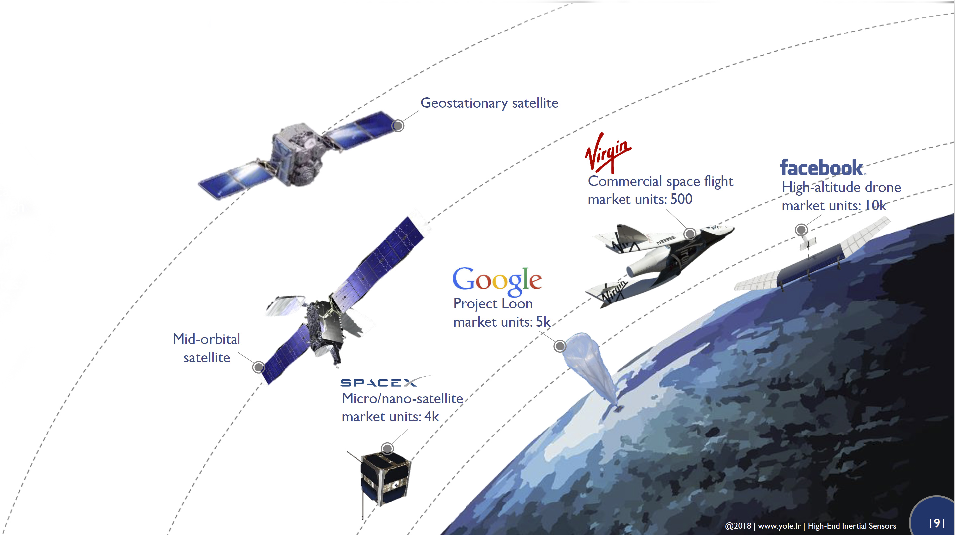
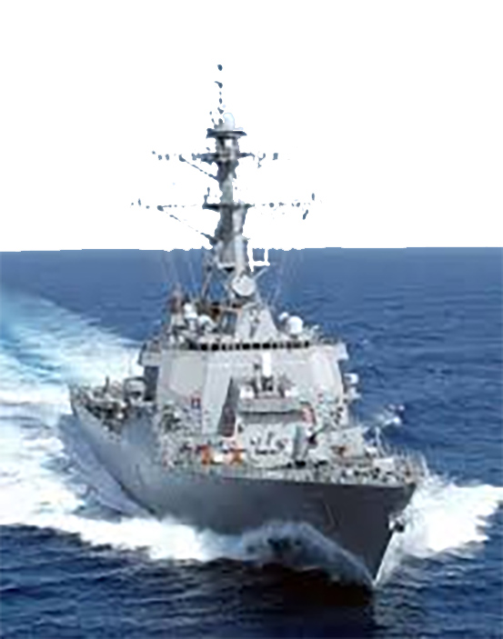
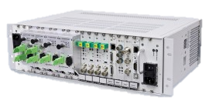
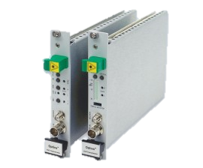
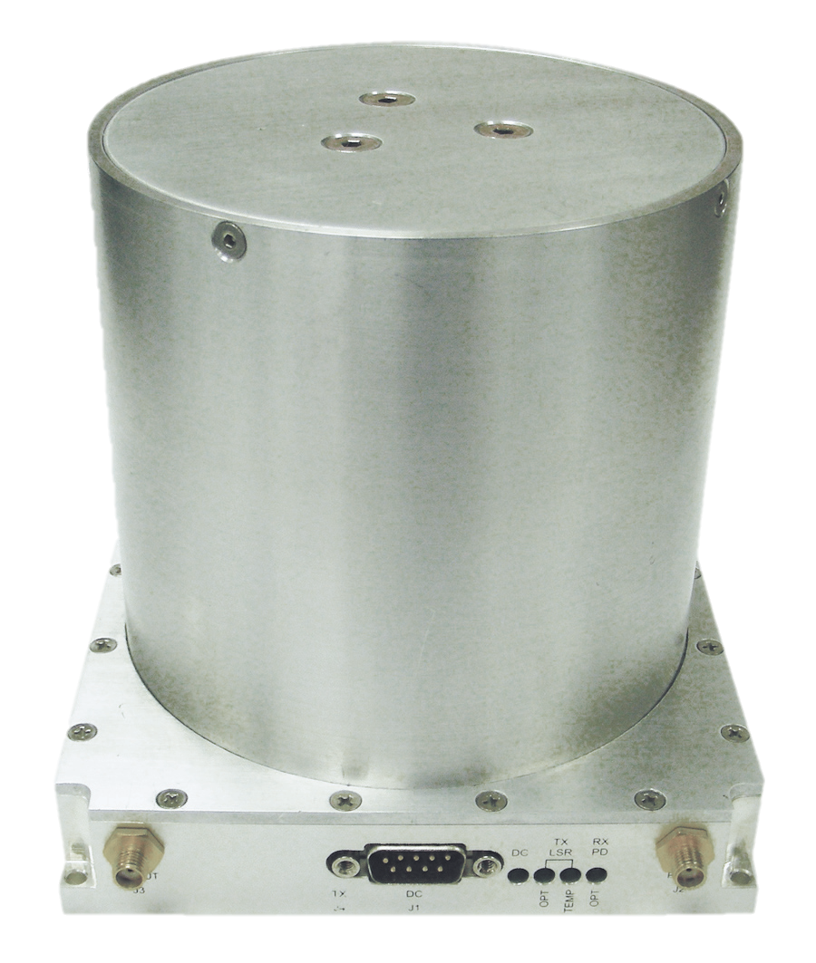
A&D – Defense Optoelectronics
EMCORE Delivers High Frequency Linear Optic Systems – transmitters and receivers that enable land transport of high frequency wireless signals over fiber
Increased satellite bandwidth is driving the demand to send high speed analog signals over optics – positioning EMCORE to capitalize on this market trend
EMCORE’s offering is vertically integrated – transmitters, transceivers, comm cards, chassis/power, and software
Growth is in areas aligned with EMCORE’s optical technology strengths:
LEO satellites (Low Earth Orbit) – high bandwidth (Q-V band), low latency (near real-time)
Fiber-optic based ISR platforms (Intelligence, Sensors, & Reconnaissance)
Mobile platforms – ships, aircraft, radar systems (FAA Control Tower)
Defense Optoelectronics Product Offering:
Optiva Microwave 40-60GHz Transmitters
High Volume Optiva L-Band Transceiver
Delay Lines for RF Test & Calibration

Slide 12
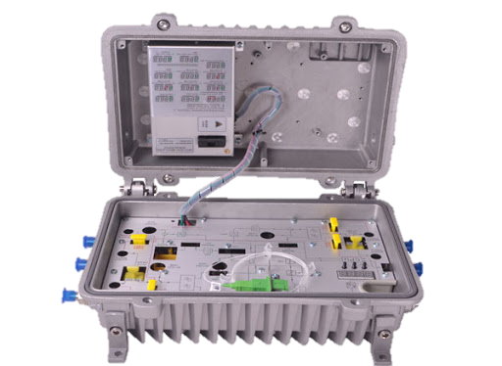
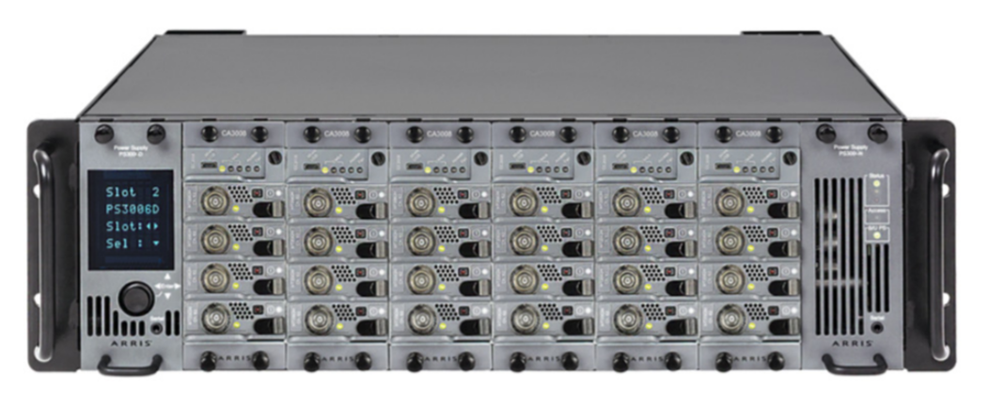
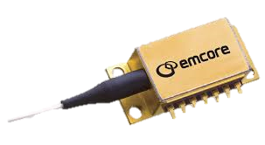
Broadband – Cable TV
Market Leader – EMCORE is the world’s leading provider of optical CATV transmitters and laser modules – the primary mode of distribution for broadband access – to OEMs for high-speed communication networks owned by multiple-system operators or MSOs (i.e. cable providers)
Technology Advantage – EMCORE’s proprietary L-EML (Linear – Externally Modulated Laser), with higher signal-to-noise ratio, enables MSOs to quickly and inexpensively distribute greater bandwidth over existing networks
Cable Access Network
Central Hub
(Digital => Analog Optics)
Optical Node
(Fiber => Coax)
Analog Signal
Over Optical Fiber
EMCORE
CATV Transmitter
Analog Signal Over Coaxial Cable
CATV Laser

Slide 13
Revenue and Gross Margin
Aerospace & Defense
Navigation market demand creates opportunities to further scale the business
Introduction of non-ITAR QMEMS products opens-up new global market opportunities
New suite of high-performance FOG products targeting a series of large customer programs
Defense Optoelectronics strengthening beyond satellite earth stations to radar systems, Navy ships, and similar applications
Continue improving QMEMS operational processes
Broadband
Communication network bandwidth demands growing incessantly
Strengthening an already market leading CATV share with L-EML
Complete transition of CATV operations to a variable cost model
Pursue Wafer Fab cost absorption opportunities, including new higher-margin prospects for the Chips business
Leverage core technology and capabilities to penetrate the LiDAR and Distributed Sensing markets
(a) See reconciliation for GAAP to non-GAAP in Appendix.

Slide 14
Operating Expenses, Profitability, and Cash
21%
Operating Expenses
Disciplined expense management
Less than 30% of revenue during the past five quarters
Operating Profit
Double-digit operating profit margins throughout FY21 (15% for full FY21)
Adjusted EBITDA
Double-digit % for the past five quarters ($28.5 million or 18% for FY21)
Cash
Positive operating cash flow during the last five quarters
$33.1 million in net proceeds from public offering in February 2021
$71.7 million at 9/30/21
29% of Rev
24%
18%
28%
23%
22%
18%
12%
13%
18%
15%
15%
9%
10%
Rising revenue, gross margin strength, and opex control driving strong operating profits
(a) See reconciliation for GAAP to non-GAAP in Appendix

Slide 15
Investment Summary
Large Navigation Market for QMEMS and FOG Growth
Superior CSWaP and Favorable Competitive Dynamics Creating High-Growth Openings for FOG Products
Core Technological and Operational Strengths Driving Top- and Bottom-Line Growth in Aerospace & Defense
L-EML Advantage Increasing Market-Leading CATV Share
Significant Operating Leverage and Strong Balance Sheet

Slide 16
Appendix

Slide 17
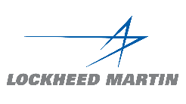
Serving Premier Customers
Aerospace & Defense (A&D)
Broadband

Slide 18
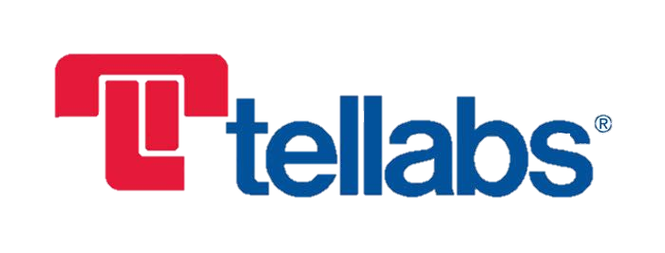
Management Team
Jeff Rittichier
President, Chief Executive Officer, and Director
Tom Minichiello
Chief Financial Officer
Albert Lu
Senior VP of Engineering
Iain Black
Senior VP of Operations

Slide 19
GAAP to Non-GAAP Reconciliations
(a) Represents costs related to transition to variable cost model in CATV Lasers and Transmitters product line.

